Slide 1



MedAssist AI
MILESTONE 4 (Testing, Deployment & Documentation)
Dharani K

Slide 2
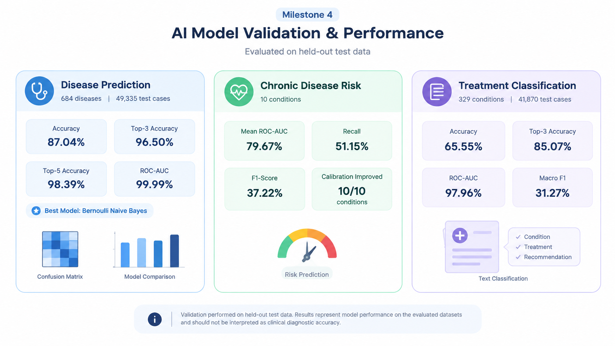

Slide 3
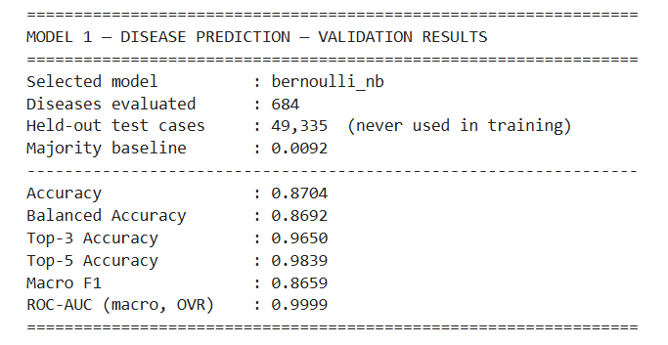
Model 1 - Disease Prediction - Validation Results

Slide 4
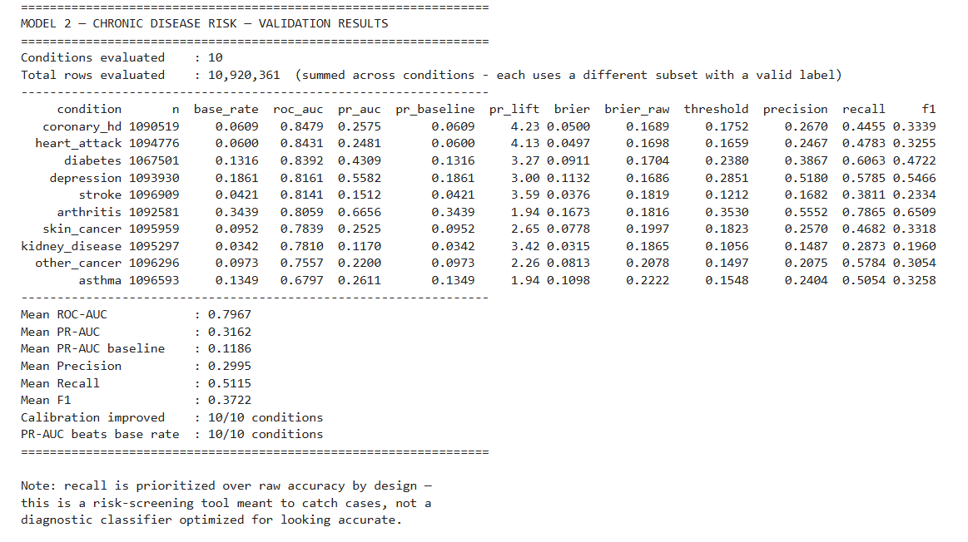
Model 2 - Risk Assessment - Validation Results

Slide 5
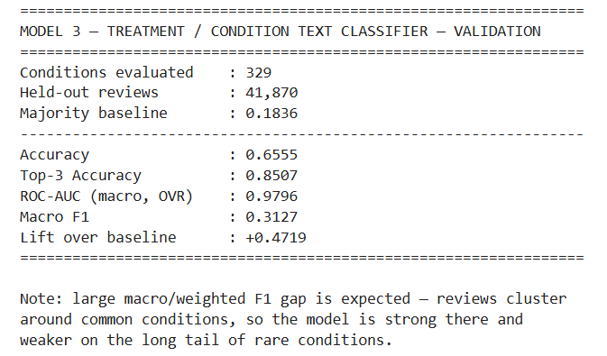
Model 3 - Treatment Recommendation - Validation Results

Slide 6
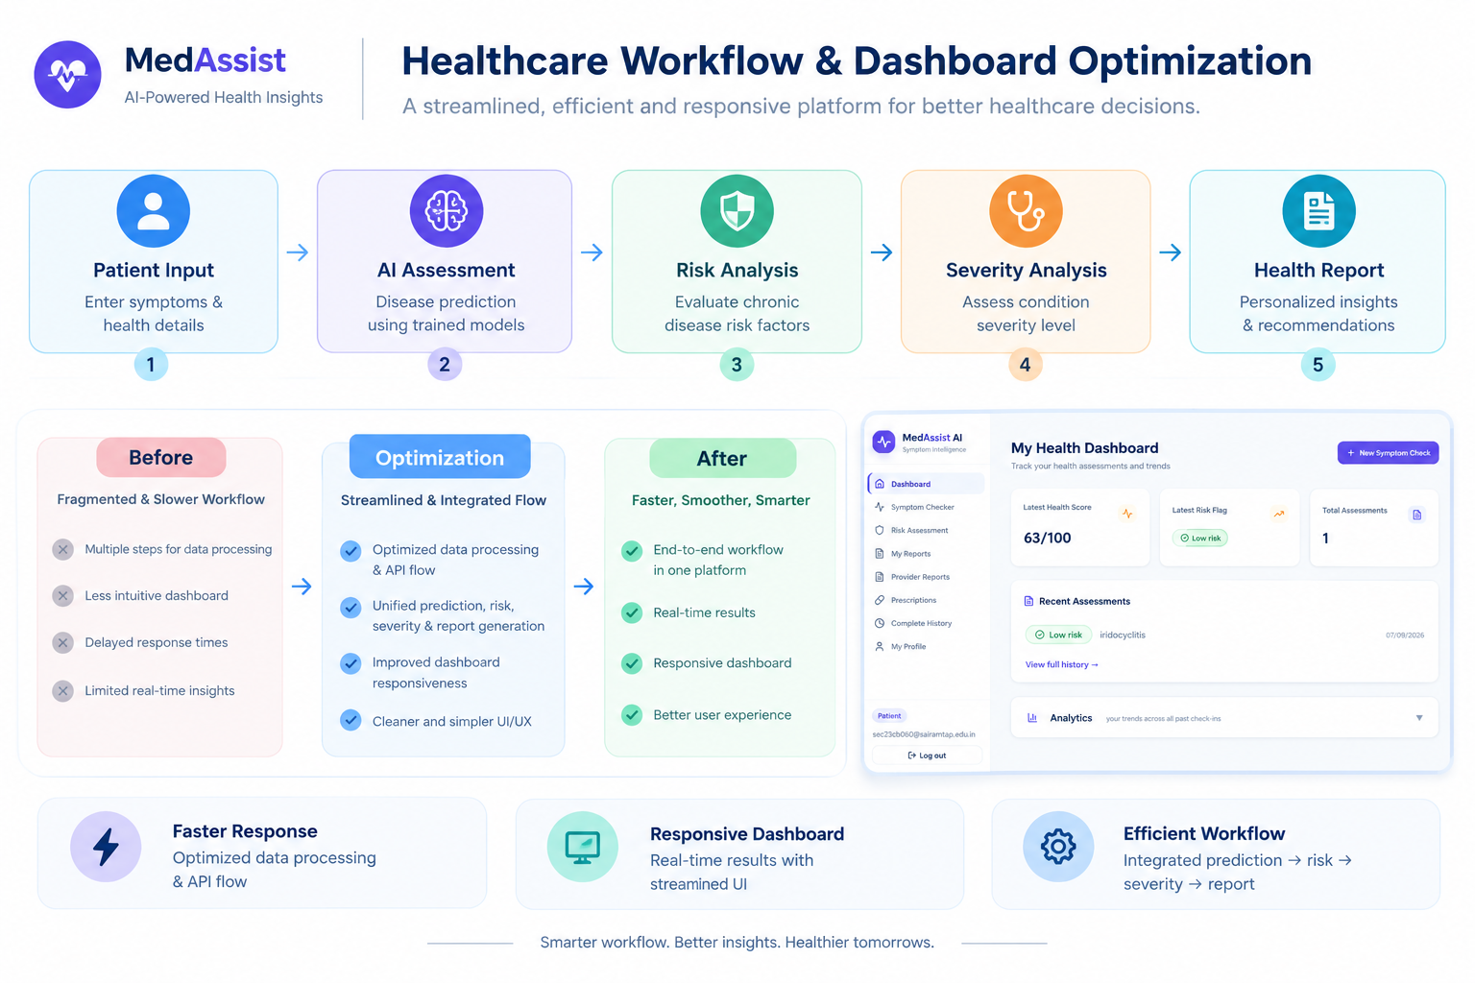

Slide 7
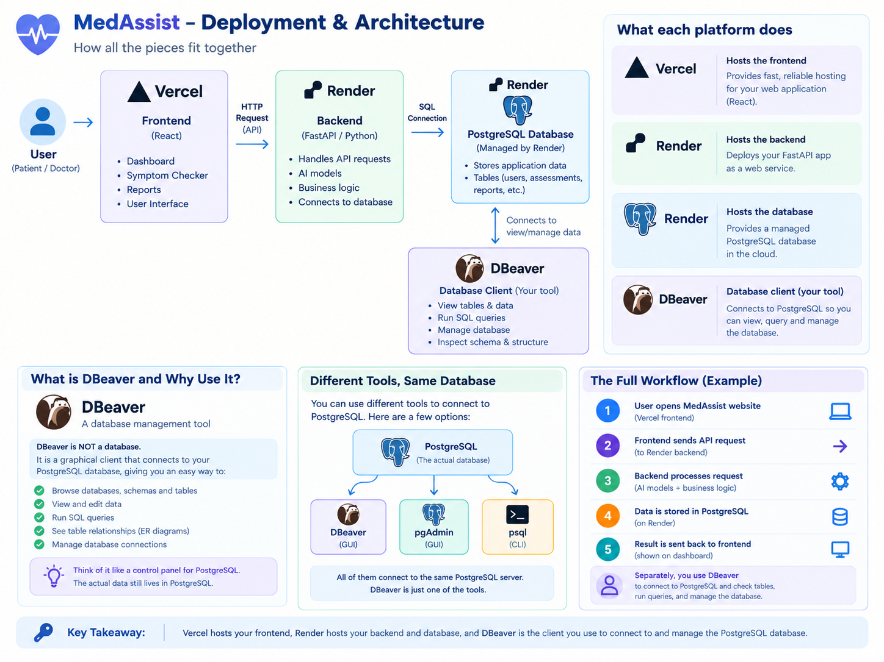

Slide 8
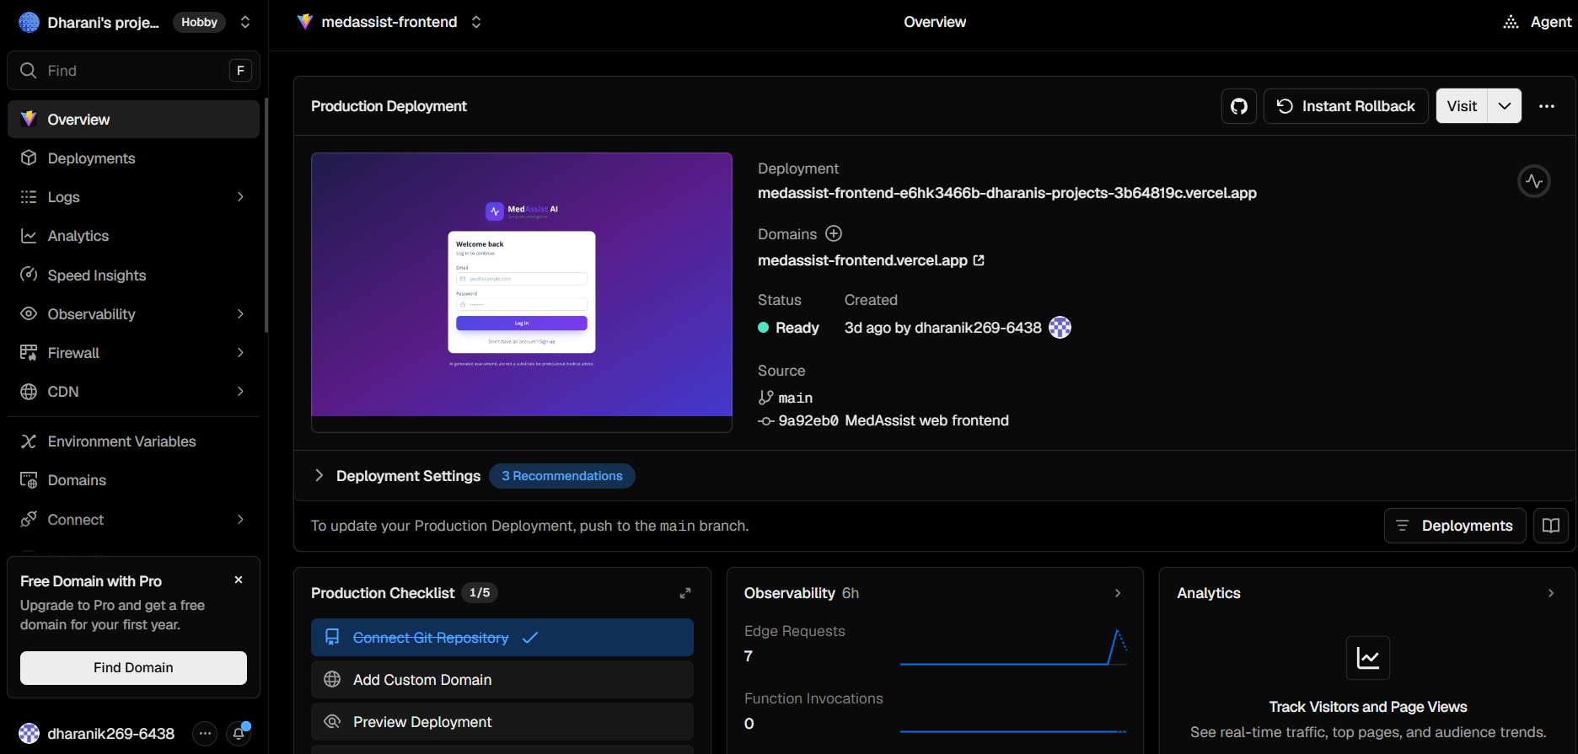
Deployment (Frontend - Vercel)

Slide 9
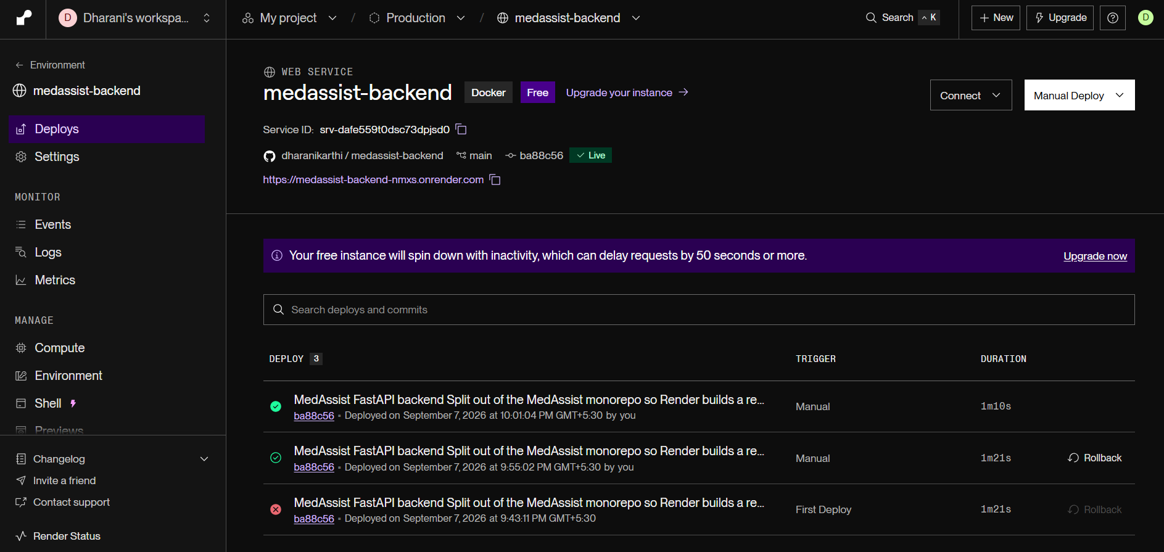
Deployment (Backend - Render)

Slide 10
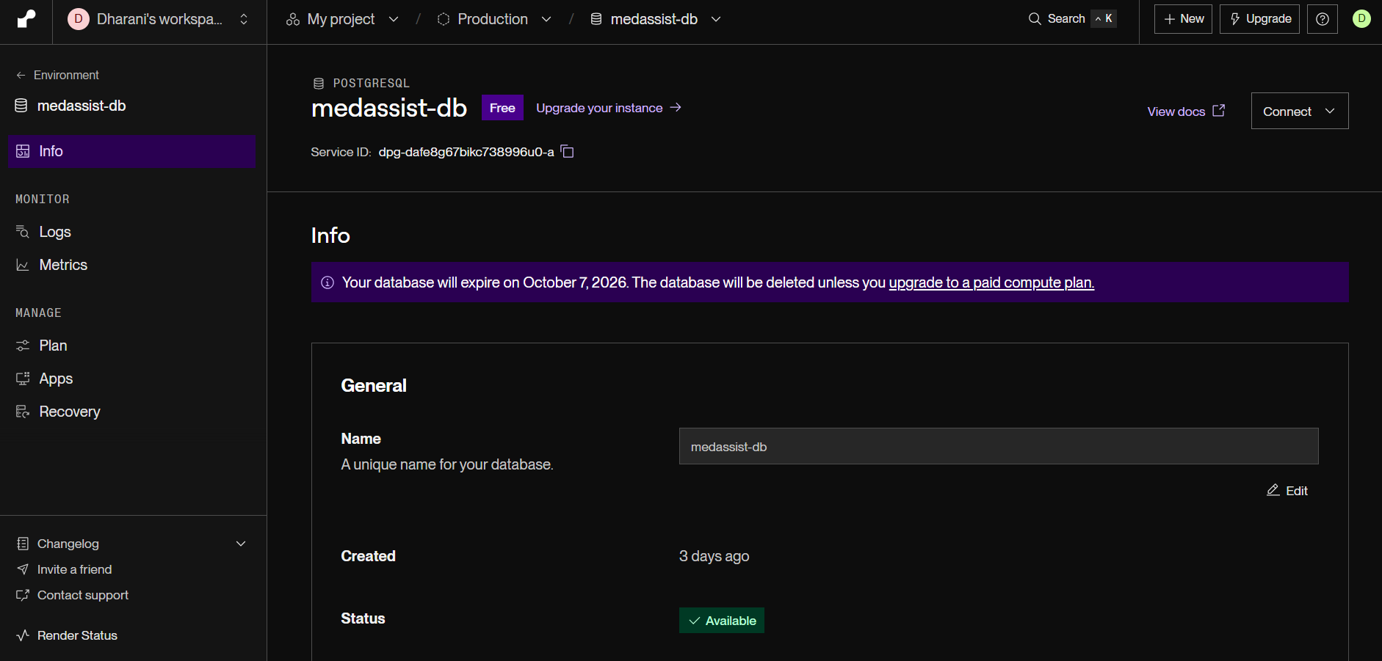
Deployment (Database - Render)

Slide 11
Links
Frontend: https://medassist-frontend.vercel.app/
Backend: https://medassist-backend-nmxs.onrender.com/docs
Documentation: https://drive.google.com/file/d/1M3oLfpdwtu5pMHR94c8KAwk0jGE3gk4v/view?usp=drive_link

Slide 12

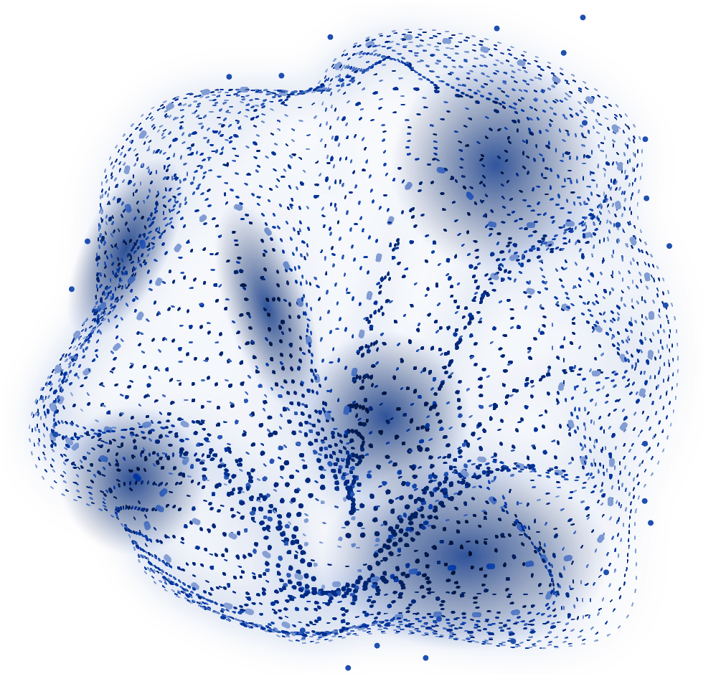
THANK
YOU!

